Slide 1
What is our direction in traffic?
Lukáš Vacek and Václav Kučera
GACR Project 20-01074S

Slide 2

Our problem
$$\frac{∂}{∂t}ρ\left(x,t\right)+\frac{∂}{∂x}\left(ρ\left(x,t\right)V\left(x,t\right)\right)=0$$

Slide 3
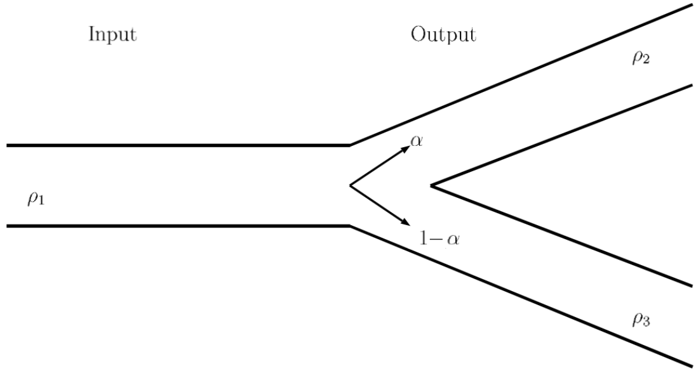
Numerical flow in the junction
Unique approach
Some advantages
Some disadvantages
We will finish the paper soon

Slide 4
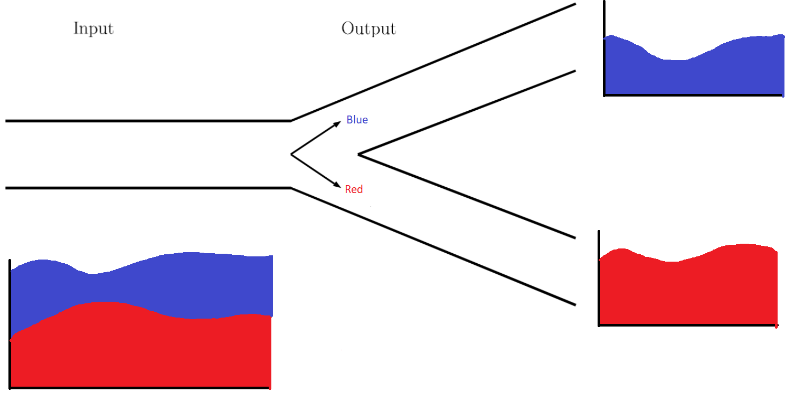
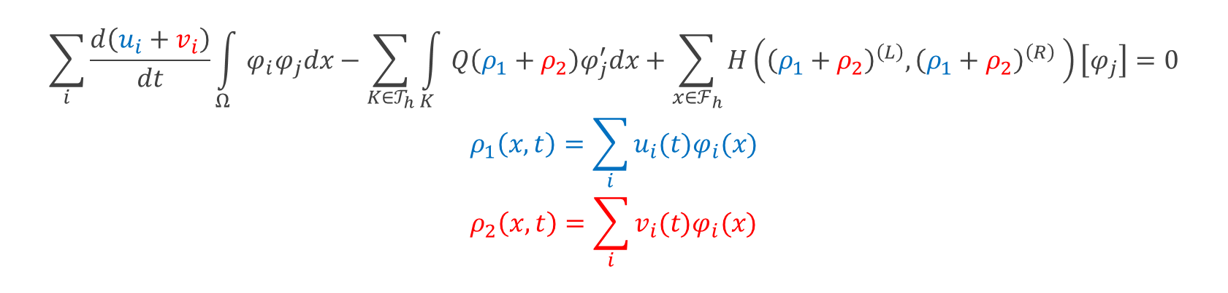
Multiple fluids
$$\sum_{i}{\frac{d\left(u_{i}+v_{i}\right)}{dt}\int_{Ω}{φ_{i}φ_{j}dx}}−\sum_{K∈𝒯_{h}}{\int_{K}{Q\left(ρ_{1}+ρ_{2}\right)φ_{j}^{′}dx}}+\sum_{x∈ℱ_{h}}{H\left({\left(ρ_{1}+ρ_{2}\right)}^{\left(L\right)},{\left(ρ_{1}+ρ_{2}\right)}^{\left(R\right)} \right)}\left[φ_{j}\right]=0$$
$$ρ_{1}\left(x,t\right)=\sum_{i}{u_{i}(t)φ_{i}(x)}$$
$$ρ_{2}\left(x,t\right)=\sum_{i}{v_{i}(t)φ_{i}(x)}$$

Slide 5
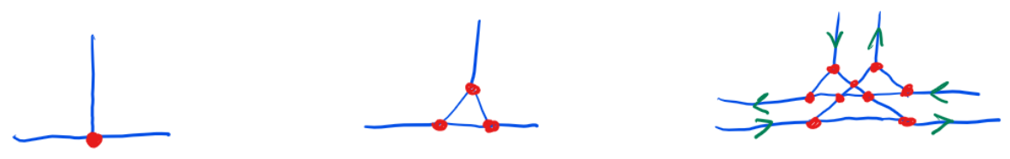
Pseudo 2D junction

Slide 6
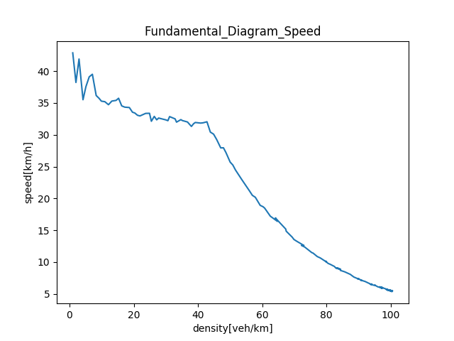
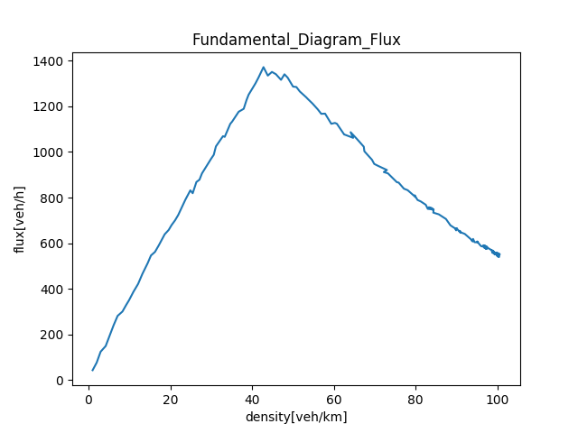
Fundamental diagrams based on micromodel
SUMO
Cooperation with ČVUT

